Slide 1
ROH / POH LOAD BALANCING OF WORKSHOP
Decision support tool which solves the problem of imbalance assignment of wagons due for ROH or POH using optimization algorithm

Slide 2
Current assignment strategy
Based on experience
Local information available to managers
In some cases, to default workshops or depos

Slide 3
Exploratory data analysis of workshop data

Slide 4
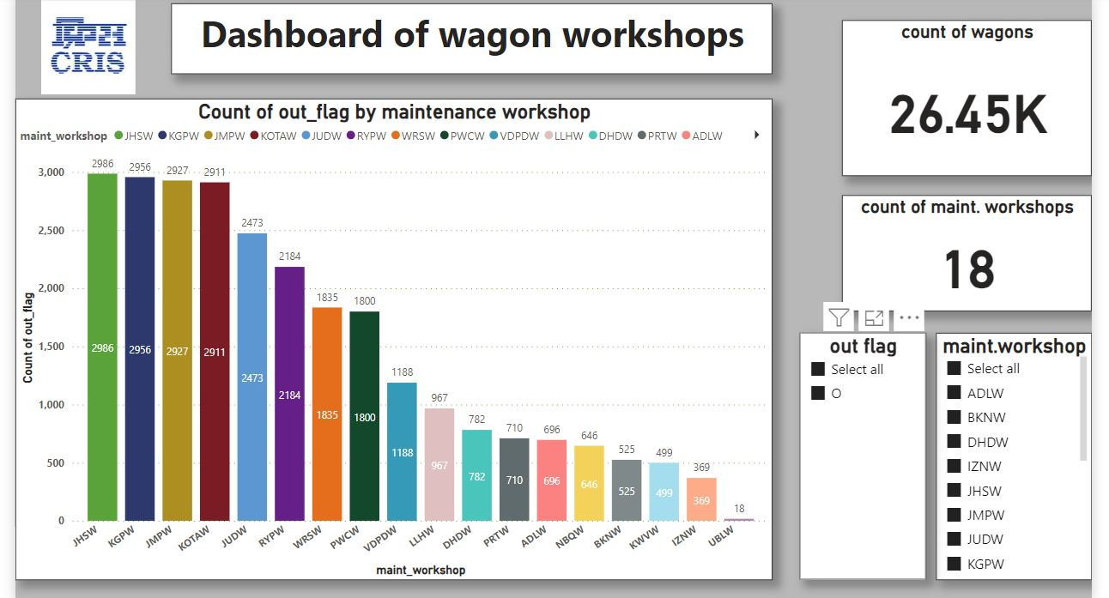
Average out-turn of workshop in 6 months

Slide 5
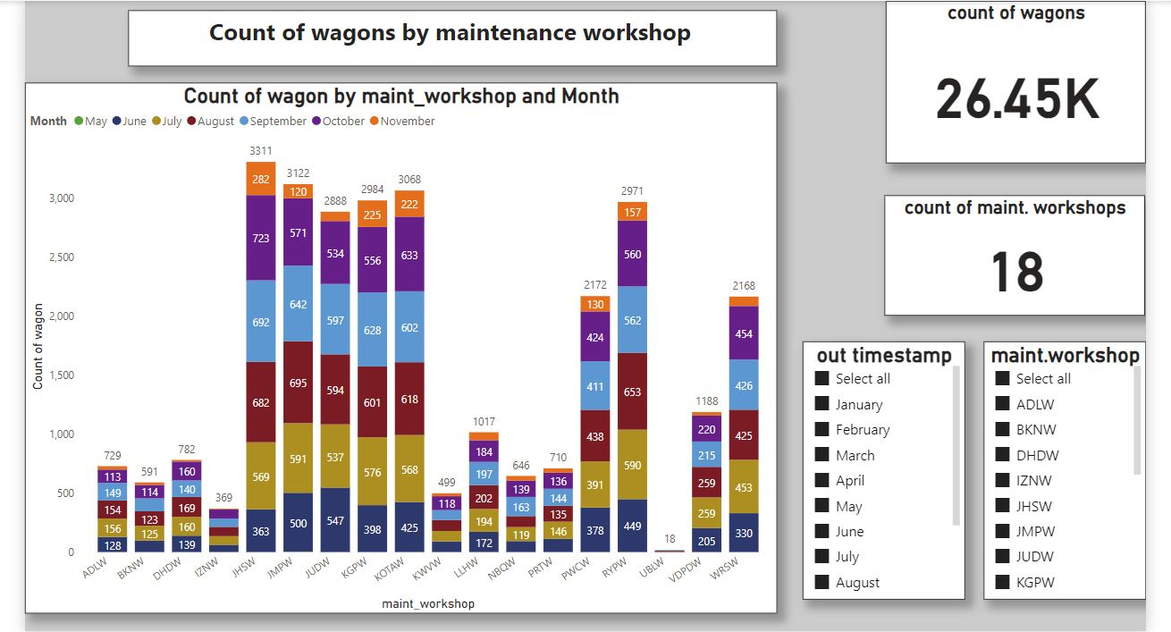
Monthly out-turn of workshop in 6 months

Slide 6
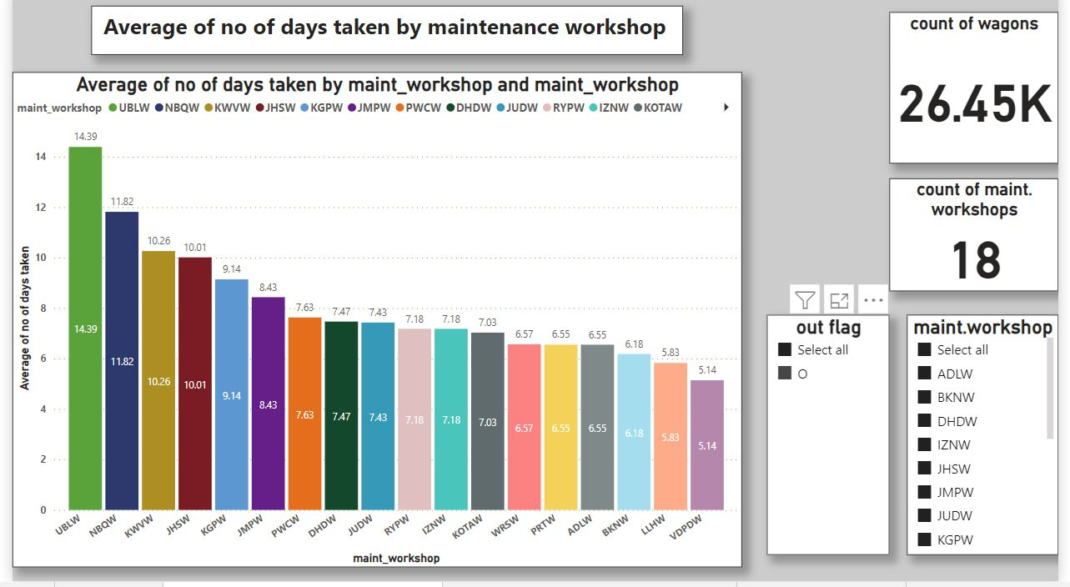

Slide 7
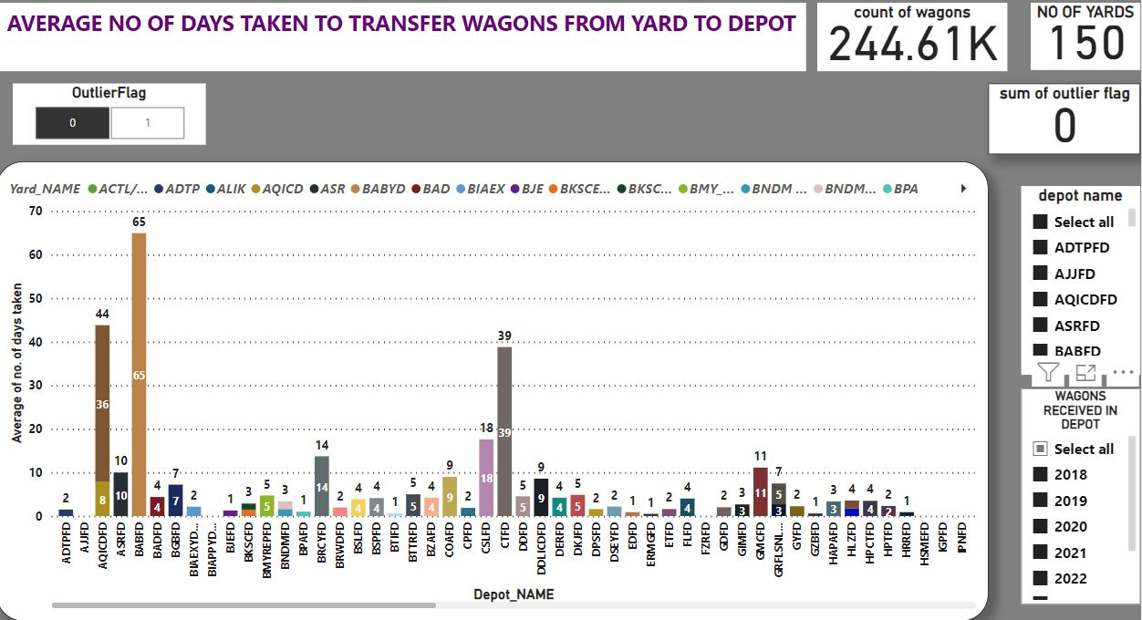

Slide 8
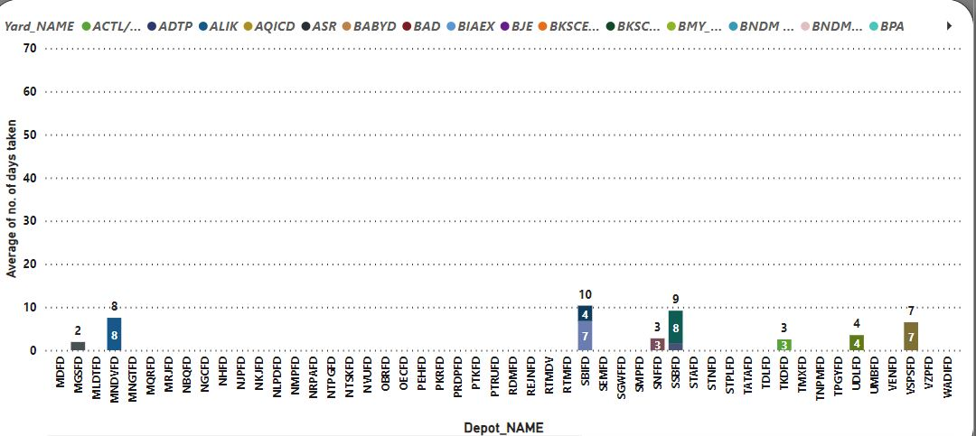

Slide 9
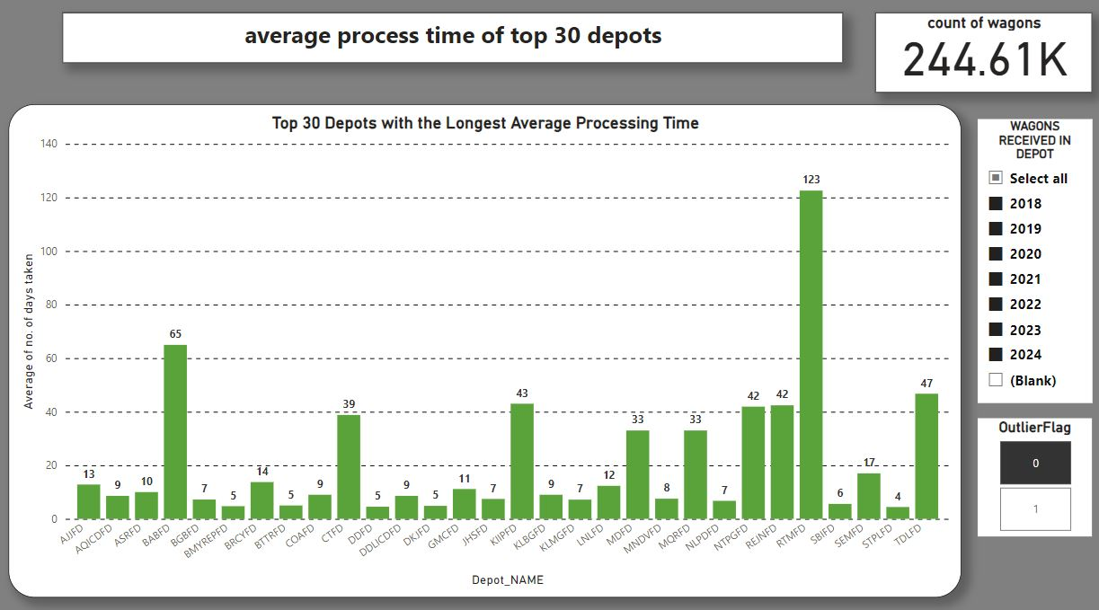

Slide 10
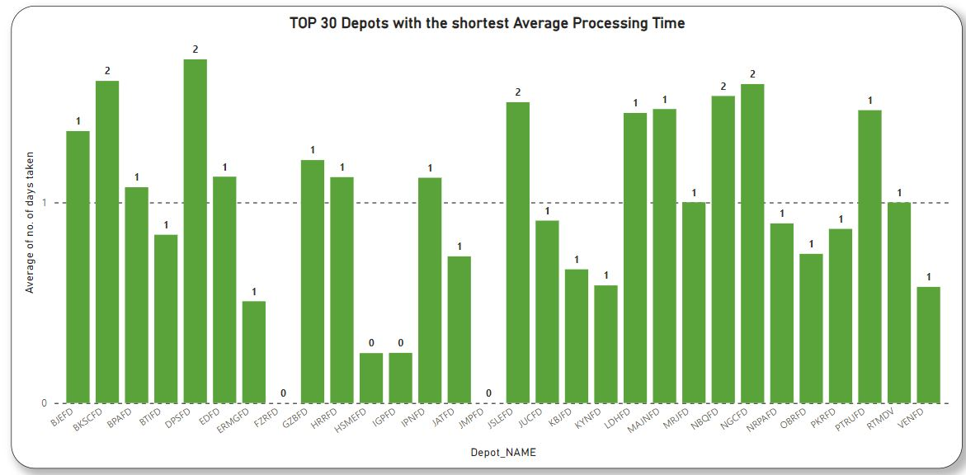

Slide 11
Drawbacks of current strategy
Results in imbalance assignment of wagons to workshop which leads to:
Some workshop becomes overloaded and other remain idle
Average waiting increases of wagons assigned to workshop or depos with excessive workload.
Underutilization of resources in workshop or depos which are idle.
This in turn impact the freight operations.

Slide 12
Our solution
Provides an assignment plan for next 10 days for wagons due for ROH or POH
Gives an optimal assignment plan for wagons due or will be going to due in next 30 days
Suggest workshop/depo to Yard while the wagon is being nominated for schedule repair (ROH/POH)
Suggest which wagons should not be sent to particular location, reasons may be;
Wagon will be due for ROH/POH on reaching destination, the maintenance location is too far from that location
Will give facility to prioritize certain wagons in case of requirement.

Slide 13
Critical parameters
Travel time of wagons/rake from current location to workshop/ROH Depot.
Age of the wagon from the date it became overdue.
Congestion or waiting time in yards associated with workshop or depos considered.

Slide 14
Inputs required
How to define capacity of the workshop or depos ??
Master data required to define which workshop or depo can handle which type of wagon.
Parameters which can be given as user input.

Slide 15
Thank you

